Slide 1
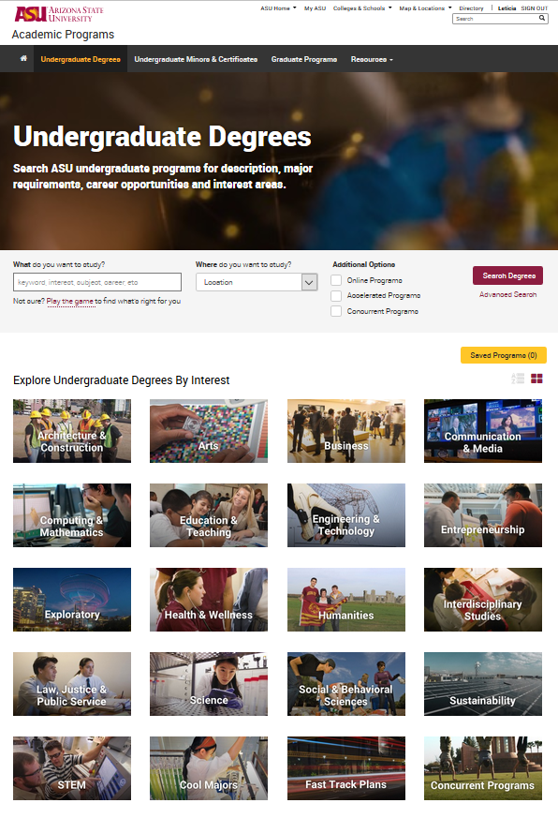
“What If” Critical Tracking Evaluation

Slide 2
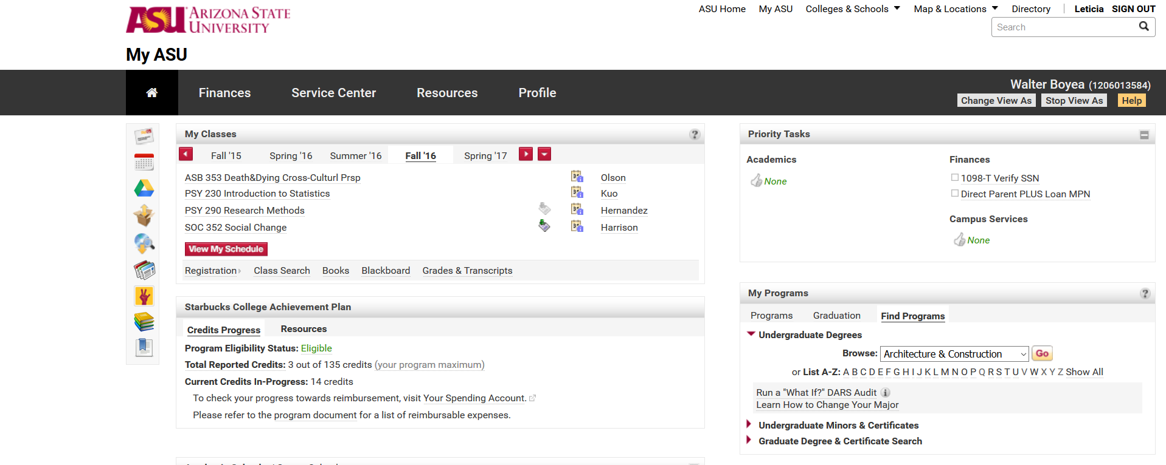
Requesting a “What If” Critical Tracking Audit through MyASU
Student Name (ID)
Included under the My Programs box is a link to Find Programs. Clicking on the “Undergraduate Degrees” arrow allows a search for a degree by interest, letter or show all.

Slide 3
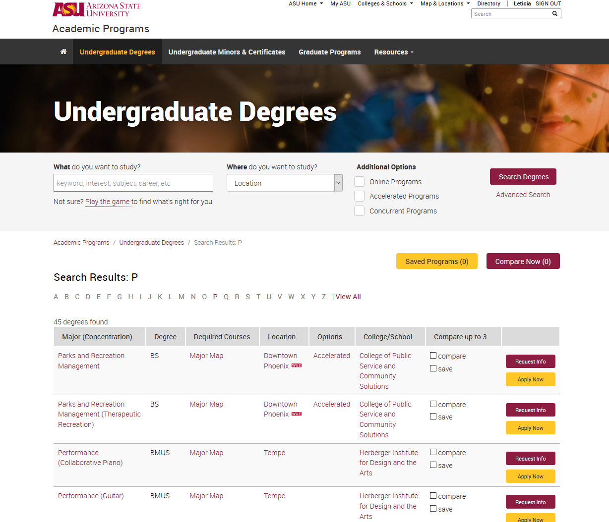
Degree Search
Once an option is chosen the user is directed to the ASU Degree Search website.
In this example the letter “P” was chosen from the previous page. The user is directed to the page to all majors starting with the letter “P”.
Parks and Recreation Management was chosen for this example.
Select the description link of the major.
If the user would like to explore another letter or search option use the back arrow button of the web page.
The user can also use the tools on the Degree Search page to narrow their search option.

Slide 4
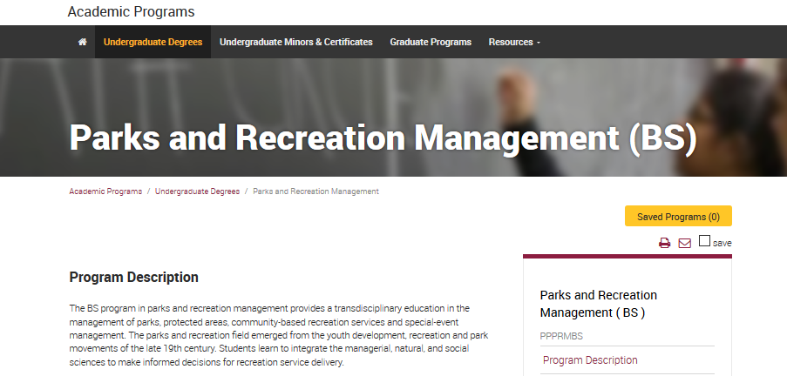
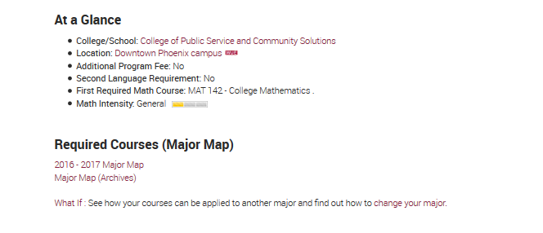
“What If” evaluation link
The user will be directed to the major information page in ASU Degree Search.
The “What If” link can be found under “Required Courses (Major Map)”.
Selecting this link will open a pop-up box with all available options for the chosen major: Ground, Online, Fast Track or subplan options.

Slide 5
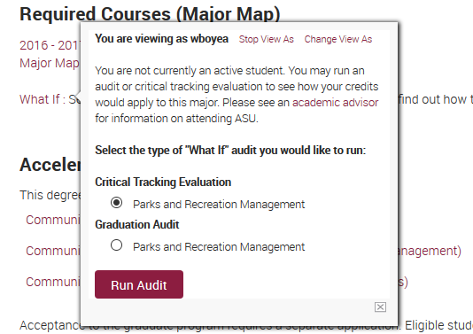
“What If” Radio Buttons/Running Evaluations
ASURite
The pop-up box will display the ASURite ID of the student at the top.
An audit can be run for a “What If” Critical Tracking Evaluation or Graduation Audit. Once a radio button is chosen click on “Run Audit”.
A new tab will open displaying that a an evaluation is being run. Once the evaluation is completed a Critical Tracking Evaluation My Major Map view will populate.

Slide 6
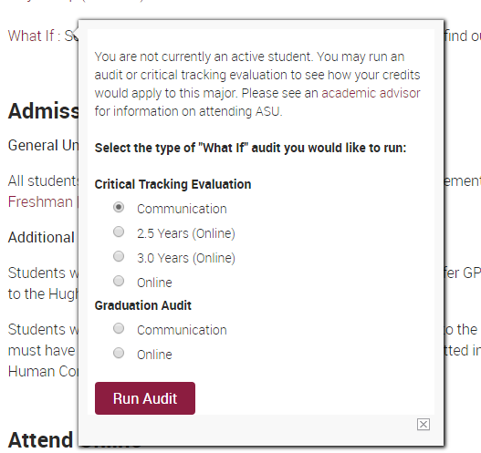
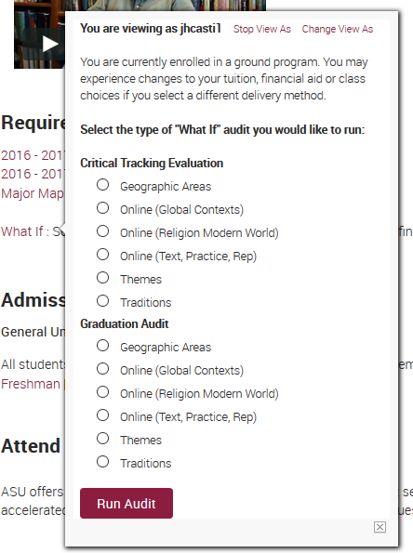
“What If” Radio Buttons Examples
The Communication, BS major has three Critical Tracking Evaluation options: Ground, 2.5 and 3.0 Years (Online) and Online.
Each shows the suggested course per term for each option.
All options lead the student to graduate from one Graduation audit, therefore only one Graduation Audit option available to run.
The Religious Studies, BA major has various Critical Tracking Evaluation options: subplans for ground and online. Each shows the suggested course per term for each option.
All options have their own Graduation Audit that can be run for each sunplan.

Slide 7
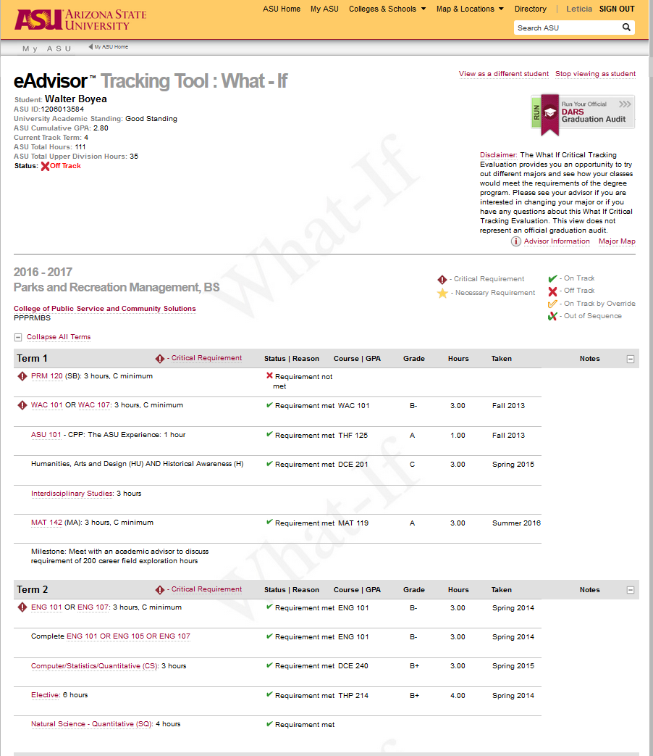
“What If” view
Student information on the upper-left hand side is the student’s current term and status information
What-if water mark shows on all Critical Tracking Evaluations
The most recent catalog year will always be run for “What If” Critical Tracking Evaluations
The “What If” Critical Tracking Evaluation shows the critical requirements and suggested sequencing per term a student should follow for the major being explored. The majority of Critical Tracking Evaluation maps show terms 1-8. Education shows terms 1-4.
The student’s ASU and transfer courses will populate the My Major map.
A green solid checkmark shows a requirement has been met.
A red X shows a requirement not met.

Slide 8
Why run a “What If” Critical Tracking Evaluation
Why would an advisor or student run a “What If” Critical Tracking Evaluation.
Undecided students exploring multiple majors
Students wanting to change their major
Students wanting to change their major to graduate on time or early
Advisors can use “What If” audits to help students plan for a new degree
Helps advisors advise students on requirements

Slide 9
Other Items
All current and past ASU students can run a “What If” Critical Tracking Evaluation through ASU Degree Search.
Advisors can run “What If” Critical Tracking Evaluations through their My ASU page or ASU Degree Search.

Slide 10
Exceptions to the rule
The following Majors are not critically tracked, therefore they do not have a Critical Tracking Evaluation Radio Button Option:
Discontinued programs
BAS programs
General Studies (BA)
Integrated Studies (BA and BS)
Interdisciplinary Studies (BA)
Interdisciplinary Arts and Sciences (BA)

