Slide 1
Diversity & Recruitment Training and Certification
Faculty & Academic Professional Positions
Office of the University Provost
Fall 2018
Notes:
Welcome to ASU Diversity and Recruitment Training and Certification for Faculty and Academic Professional positions.
ASU is committed to a recruitment process that results in the hiring of the most qualified applicants. All individuals with authority to hire will be accountable for the recruitment, retention, and development of diverse faculty and academic professionals.

Slide 2
ASU Charter
ASU is a comprehensive public research university, measured not by whom it excludes, but by whom it includes and how they succeed; advancing research
and discovery of public value; and assuming fundamental responsibility for the economic, social, cultural and overall health of the communities it serves.

Slide 3
Eight design aspirations guide ASU’s ongoing evolution as a New American University. ASU integrates these institutional objectives in innovative ways to demonstrate excellence, access and impact.
Leverage Our Place
ASU embraces its cultural, socioeconomic and physical setting.
Transform Society
ASU catalyzes social change by being connected to social needs.
Value Entrepreneurship
ASU uses its knowledge and
encourages innovation.
Conduct Use-Inspired Research
ASU research has purpose and impact.
Enable Student Success
ASU is committed to the success of each unique student.
Fuse Intellectual Disciplines
ASU creates knowledge by
transcending academic disciplines.
Be Socially Embedded
ASU connects with communities
through mutually beneficial partnerships.
Engage Globally
ASU engages with people and
issues locally, nationally and internationally.

Slide 4
Basic guidance and principles for searches
Notes:
What are the basic considerations in conducting a search that advances the twin goals of diversity and quality?

Slide 5
ASU Commitment to Diversity in Employment
Arizona State University will:
Recruit and hire the most qualified applicants.
• Recruit, retain, and develop a diverse qualified workforce.
• Comply with EO/AA principles and state and federal laws.
Hold each individual with authority to hire accountable for recruitment, retention and development of a diverse workforce.
Apply ABOR and ASU policies consistently
Notes:
ASU promotes equal opportunity through affirmative action in employment and educational programs and activities. Discrimination is prohibited on the basis of race, color, religion, national origin, citizenship, sex, sexual orientation, gender identity, age, disability, special disabled veteran status, other protected veteran status, newly separated veteran status, and Vietnam era veteran status. Equal employment opportunity includes but is not limited to recruitment, hiring, promotion, termination, compensation, benefits, transfers, university-sponsored training, education, tuition assistance, and social and recreational programs.
“Equal opportunity” results when all applicants are treated consistently and when policy is applied equally to all applicants at each stage of recruitment.
Occasionally, it may be in the best interests of the university to conduct a “focused recruitment” to designate a candidate for hire without using the process described in this handbook. In such cases, the hiring authority should prepare a brief memo describing the reason(s) for a focused recruitment. For tenure, tenure-track and fixed-year appointments, the Vice Provost for Academic Personnel (or designee) must be consulted. The memo must be maintained in the position file.

Slide 6
Policies & resources
Faculty and Academic Professional Search Handbook, PowerPoint presentation, sample documents, etc. on the provost’s webpage for Faculty and Academic Professional Search
Notes:
A number of very helpful resources for faculty and AP searches are available at http://provost.asu.edu/academic_personnel/search .
For information and a step-by-step guide about university recruitment policies and procedures, please download a current copy of the Faculty and Academic Professional Search Handbook:
https://provost.asu.edu/sites/default/files/rss/academic_recruitment/AcademicSearchHandbook10_12_2011.pdf
This handbook is designed to guide you through a search in a way that helps you comply fully with the federal, ABOR, and ASU requirements.
For sample letters and ads and a complete checklist for the recruitment process: https://provost.asu.edu/forms
Other resources may also be found at that site.

Slide 7
Policies & resources
Related EO/AA policies:
ACD 401; SPP 101– Equal Opportunity/Affirmative Action http://www.asu.edu/aad/manuals/acd/acd401.html
ACD 405; SPP 105 – Americans with Disabilities http://www.asu.edu/aad/manuals/acd/acd405.html
ABOR 1-119 & ABOR 1-120 addresses non-discrimination matters
Notes:
Diversity & Recruitment Policies & Resources
For information about university recruitment policies and procedures, please consult:
Faculty and Academic Professional Search Handbook:
https://provost.asu.edu/sites/default/files/rss/academic_recruitment/AcademicSearchHandbook10_12_2011.pdf
For related EO/AA policies:
ACD 401; SPP 101– Equal Opportunity/Affirmative Action
http://www.asu.edu/aad/manuals/acd/acd401.html
ACD 405; SPP 105 – Americans with Disabilities
http://www.asu.edu/aad/manuals/acd/acd405.html
Arizona Board of Regents policies also address non-discrimination matters:
http://azregents.asu.edu/rrc/Policy%20Manual/1-119-Nondiscrimination%20and%20Anti-Harassment.pdf
http://azregents.asu.edu/rrc/Policy%20Manual/1-120-Equality%20of%20Opportunity.pdfp://azregents.asu.edu/rrc/Policy%20Manual/1-119-Nondiscrimination%20and%20Anti-Harassment.pdf

Slide 8
Failed searches
A successful search may come up empty, but a failed search is one in which the wrong person was hired
Notes:
The search process seeks to identify the most qualified person possible for the position, with the intent that this person will go on to be very successful at ASU for years to come.
Sometimes a search may not result in a hire in a given year, for various reasons, but that can be the result of a careful review of the pool for the process. In that case, not hiring anyone for a search need not be seen as a failure.
Rather, a search fails when a person is hired who winds up not being successful at ASU because the match between the expectations for the person and expectations for the successful hire in the position was poor. This is what a careful search process seeks to avoid while attempting to find the most qualified person in the most diverse applicant pool possible. In that sense, in such cases the “wrong” person was hired. This failure may not become obvious immediately.

Slide 9
Some keys to successful searches
Consider what you really need in the position you are filling: essential functions, required qualifications
Think about ways to embed diversity as an intellectual/academic component of the job
Conduct a broad look in the marketplace for potential colleagues – this improves the quality and diversity of your search
Move quickly and advance your search
Use rolling deadlines – keeps your options open
Notes:
There is no set bag of magic tricks that leads to success in a search. However, these four practices are broadly applicable to searches, and we’ll talk about each of these more later in the presentation.
The search will pivot about the essential functions and required qualifications you identify.
You cannot find the most qualified applicants without a broad search. A search is an active process and depends on a search committee’s intentional and determined efforts to identify and attract the strongest pool of applicants.
You must continually push this aspect of your institutional service toward the top of your tasks each day. The search with which you are involved is being performed in a highly competitive environment, so it is essential to keep this important service contribution on your radar.
Rolling deadlines can keep options open for you, but there is a “right” way and a “wrong” way to specify a rolling deadline. We’ll talk more about that later.

Slide 10
Some successful strategies for increasing diversity
Notes:
Let’s go over some sample ideas that some units have used to increase the diversity of the pool of applicants. These ideas may be discipline-specific, so you may need to brainstorm about ways your search committee might accomplish the same goal.

Slide 11
Recruitment strategies for enhancing faculty diversity
Create job descriptions that clearly address ASU’s dedication to diversity so that diverse groups of highly qualified candidates are inclined to apply.
Review programs for premier conferences in your discipline and those of disciplinary organizations.
When attending these conferences, participate in the various caucuses devoted to diverse fields of study and attend panels that feature faculty and/or graduate students interested in such topics.
Notes:
Every search is different, but here are some strategies others have tried in order to make sure their applicant pool was as deep and diverse as possible:
For this specific search:
1. Identify top 5-10 women and minority journals in your discipline (last 12 months).
2. Review programs for premier conferences in your discipline (last 12 months), and those of disciplinary minority organizations.
3. Contact top 10 departments in the nation and collaborate to identify:
a. Recent and soon-to-be PhDs and post-docs (as potential new assistant professor hires).
b. Senior scholars (as potential speakers or visiting scholars)
4. Generate a list of advertising outlets that reflect diverse constituents.
5. From the above searches, generate a list of 10-15 diverse candidates for potential hire on tenure track.
Ongoing:
1. Provide a report of current diversity and diversity of new hires annually.
2. Review national discipline-specific availability data (anticipating the University Office of Diversity will provide this).
3. Include strategies for diversification in annual hiring plan.
4. Coordinate cluster hires with related disciplines using vehicles such as Southwest Borderlands Initiatives.
5. Create job descriptions that clearly address ASU’s dedication to, and appreciation of, diversity, so that diverse groups of highly qualified candidates are inclines to apply for positions.
6. Post job descriptions for an adequate length of time in a variety of outlets with wide national and international circulation, including print (e.g., Chronicle of Higher Education), web-based media. Target professional organization channels and outlets that target underrepresented groups.
7. Ensure search committees are gender and ethnically diverse and work to strategically disseminate information about openings (e.g., through their diverse professional networks).
Involve faculty/staff and student organizations in applicants’ interviews (e.g., Chicano Latino Faculty Staff Association).
Conveying Enthusiasm for Diversity :
Recruit visiting scholars for diverse backgrounds.
Highlight research/outreach efforts related to diversity on web page.

Slide 12
Further suggestions to identify a diverse pool of candidates
Identify the top 5-10 women and minorities publishing in your discipline.
Contact the top 10 departments in the nation and collaborate to identify:
Recent and soon-to-be PhDs and post-docs (as potential new assistant professor hires).
Senior scholars (as potential speakers or visiting scholars )
From the above efforts, generate a list of 10-15 women and/or minority candidates for potential hire on tenure track.

Slide 13
Advertise in outlets that reflect diverse constituencies
General: Diverse: Issues in Higher Education (formerly Black Issues in Higher Education); see http://diverseeducation.com (also note their “Top 100 Producers of Minority Degrees”)
Native American: Tribal College Journal of American Indian Higher Education, Native Peoples Magazine (not directly aimed at scholars, but many NA faculty members subscribe), Indian Country Today (same as above, international in scope)
Scholarly journals that include ads: Studies in American Indian Literatures, American Indian Culture and Research Journal, American Indian Quarterly, and Wicazo Sa Review.
Notes:
Here are some common venues for seeking candidates from diverse constituencies.
ASU currently pays for all nationally-advertised faculty postings to be placed in Diverse: Issues in Higher Education.
Consider other venues to target other groups.

Slide 14
Advertise in outlets that reflect diverse constituencies (cont’d)
African American & Ethnic Studies: Journal of Blacks in Higher Education, African American Review, Meridians, Afro-Hispanic Review, Callaloo: A Black South Journal of Arts & Letters, CLA Journal
Ethnic & Racial Studies: DuBois Review: Social Science Research on Race, Journal of African American History, Journal of Black Studies, MELUS: The Society for the Study of the Multi-Ethnic Literature of the United States, National Political Science Review, Phylon, Souls: A Critical Journal of Black Politics, Culture & Society, Urban League Review: State of Black America
Notes:
Here are some common venues for seeking candidates from diverse constituencies.
ASU currently pays for all nationally-advertised faculty postings to be placed in Diverse: Issues in Higher Education.
Consider other venues to target other groups.

Slide 15
Advertise in outlets that reflect diverse constituencies (cont’d)
Hispanic: Hispanic Outlook, American Association of Hispanics in Higher Education
Women’s Studies: Feminist Studies, Journal of Women’s History, NWSA Journal, Women’s Review of Books, Women’s Studies International Forum, SIGNS – Journal of Women in Culture & Society
listservs (low cost) that reach out to diverse populations:
Sisters of the Academy: http://www.sistersoftheacademy.org/ Mujeres Activas en Letras y Cambio Social (for Latinas and indigenous women): http://malcs.org/
Notes:
Here are some additional common venues for seeking candidates from diverse constituencies.

Slide 16
Search committees
Notes:
Let’s go over some basic points about search committees.

Slide 17
Search committees
Hiring authority (chair, dean or provost) determines the search committee’s charge in keeping with unit and college bylaws and university policy.
Search Committee may be asked to:
Develop position announcement(s)
Screen applications
Conduct interviews
Conduct reference checks
Make reports to the hiring authority. Normally, reports list each candidate’s strengths/weaknesses, but do not rank candidates.
Notes:
Search committees are often used to develop position announcements, screen applications, conduct interviews, conduct reference checks, and make recommendations to the hiring authority about whom to hire for a position.
The hiring authority provides the charge to the search committee. That charge by the hiring authority sets the stage for how the search committee will operate. This slide provides a list of things search committees might be charged to do. However, academic unit bylaws and/or the hiring authority often determine the specific role of a search committee. For additional information, please refer to ACD 111-01: Faculty Voting Rights.

Slide 18
Critical points
for search committees
• Actively develop diverse applicant pool for the position
• Proactively address incomplete applications
• Chair of the committee is the primary contact with applicants
• Maintain confidentiality throughout search
• Develop criteria to evaluate applicants BEFORE looking at applicant pool
• Develop an interview agenda & questions
Committee Chair or designee should attend interview functions to ensure inappropriate topics are avoided
Notes:
Critical steps for the search committee include:
• Actively recruit applicants for the position. A passive search committee, merely waiting for applications to come, is rarely successful in finding the best applicants or the best hire.
• Determine whether to offer applicants who submit incomplete applications the opportunity to provide the missing application material; this should be done consistently so that either all applicants missing some part of the application material are provided this opportunity or no applicant is provided this opportunity.
• Normally only the chair of the committee will communicate with applicants about the status of their application and/or the recruitment process.
• Assure appropriate confidentiality at each stage of the search; see Appendix A of the Faculty and Academic Professional Search Handbook for information about the use of emails in the search process.
• Develop criteria to use in evaluating whether applicants meet the required and desired qualifications before evaluating applications, and assure each committee member uses these criteria; see Appendix E of the Faculty and Academic Professional Search Handbook for information about screening criteria.
• Develop an interview agenda, including questions, for search committee interviews; assure each individual interviewed is asked the same basic set of questions. However, each interview may follow up on different ideas and themes that emerge specific to the individual’s answers.
• While the Committee Chair should try to attend all interview functions, at least on person from the search committee should attend all interview functions (unless the function is a one-on-one meeting) to assure inappropriate questions/topics are prevented; see Appendix F of the Faculty and Academic Professional Search Handbook.

Slide 19
Notes:
https://www.youtube.com/watch?v=g3Dh2Bzi2ag&feature=youtu.be

Slide 20
Search process
Notes:
Now let’s discuss some important elements of the search process.

Slide 21
Faculty and Academic Professional Search Plan (FAP-SP)
Initiated by: The unit hiring authority or designee.
Approvals: The unit hiring authority or designee.
Purposes:
Documents the essential functions for every position for which a search is conducted.
Documents recruitment strategies to be used to ensure a qualified, diverse, and inclusive applicant pool
Submit to: Office of Equity and Inclusion (OEI) for assignment of a job order number and posting to the ASU employment website. Any ad copy developed to support external recruitment efforts must be submitted with the FAP-SP. (Must be submitted to OEI and posted on ASU page before posting at other sites.)
Notes:
The Faculty and Academic Professional Search Plan is the summary statement of the strategy and techniques to be employed during the search. Since the unit hiring authority bears responsibility for the conduct of the search, the FAP-SP is initiated and approved by the hiring authority.
The FAP-SP is submitted to the Office of Equity and Inclusion for assignment of a job order number and posting to the ASU employment website. Any ad copy developed to support external recruitment efforts must be submitted with the FAP-SP, and must be submitted to OEI and posted on ASU page before posting at other sites.
Comments:
It is the policy of ASU to promote open and competitive searches for all faculty and staff hires. The FAP-SP creates an important record that demonstrates the recruitment strategies used to create a qualified, diverse and inclusive applicant pool. We have a commitment to advertise in minority outlets and we expect to see those used in search plans.

Slide 22
Framing your search:
Essential functions
Required qualifications
Desired qualifications
Notes:
Your search is framed around three key statements:
Essential functions
Required qualifications
Desired qualifications
Let’s look at these.

Slide 23
Statement of essential functions:
the core or required duties of a position
Example: Advertisement for Assistant/Associate Professor
• Contribute to curriculum development
• Deliver instruction at the undergraduate, master’s, and doctoral level
Supervise honors, master’s and doctoral Students
• Conduct research publishable in top-tier academic journals in the discipline
• Participate in professional and university service
• Develop grant proposals for external funding as PI or co-PI.
Identifies the key abilities needed for a person to succeed in job.
A statement of essential functions is required by the Americans with Disabilities Act. Though not required to be included in advertisements, ASU must have these on file for every position.
This statement guides the recruitment and selection activities.
Notes:
The Americans with Disabilities Act (ADA) requires ASU to identify the essential functions for all positions.
• the core or critical duties of a position that, in effect, define the job;
• used in helping determine whether a requested accommodation for a disability is appropriate; and
• used in assisting the determination of whether an applicant can perform or an employee is performing the job, with or without accommodations.
The following are the federally defined criteria for determining essential functions of a position:
• the reason the job exists is to perform a particular function (e.g., clean rooms for a custodial position);
• there are a limited number of employees available among whom the performance of a job function can be distributed (e.g., perform medical examinations for a physician position);
• function may be highly specialized so that a person is hired for his/her expertise or ability to perform a particular function (e.g., conduct DNA testing for a research specialist position);
• employer’s judgment that a function is essential (e.g., answer phones for a receptionist position);
• the amount of time spent on the job performing the function makes it essential (e.g., provide programming to create reports for a computer programmer position);
• the consequences of not requiring the incumbent to perform the function make it essential (e.g., landing planes for a pilot position);
• the work experience of past incumbents in the job makes a function essential (e.g., maintain budget information for a program coordinator position); and
• the current work experience of incumbents in similar jobs (e.g., provide word processing for an office assistant position).
Essential Functions and Required Qualifications – too often we structure our advertisements around minimums we would never really be satisfied with. Therefore, essential functions and required should be based on what it is we expect the faculty member or AP to actually do. If, for example, the position requires external funding to be successful in this position then the required quals need to state something like “must have demonstrated interest in and willingness to compete in external competitive grant competitions from appropriate federal and other sources” if a new Ph.D. and perhaps for experienced faculty for more senior ranks something like “must have demonstrated sustained success in securing external funding from federal and other agencies as principal investigator” For the new Ph.D., the measure of interest and willingness could be the person participated in writing grants or helping to write grants as a doc student, worked on external grants and understands the need, etc. You determine what constitutes demonstrated interest and willingness. Could be that it must be reflected in the applicant’s cover letter for the position explaining how their work would be advanced through external funding. For the experienced person could be number of grants funded as PI over the last 5 years. If employing graduate students is an important criteria from external funding, then seek such people who have a record of doing that. Just don’t set essential functions and minimums that are not really practical – the language of minimum and desired does not really serve us well – you should think in terms of necessary and optimum as better ways to distinguish what you should be thinking about in preparing the advertisement and screening process.

Slide 24
Required qualifications
Required qualifications ensure that an applicant can perform the essential functions of the position.
These qualifications should be specific enough (i.e., measurable) to assure the hiring authority that applicants will have the necessary education, experience, and/or knowledge to perform the essential functions.
If terminal degree is required, please specify whether it needs to be in-hand at time of application or completed by time of appointment.
Only applicants meeting the required qualifications are eligible for further consideration in the search.
Notes:
Qualifications
Qualifications are the education, experience, and/or knowledge needed to perform the essential functions of a position. Key issues to consider in developing qualifications are:
• State qualifications clearly and distinguish between required qualifications and desired qualifications.
• Required qualifications should assure that applicants can perform the required essential functions of the position. These need to be specific (measurable) enough to assure the hiring authority that applicants have the necessary education, experience, and/or knowledge to perform the essential functions. See Appendix D of the Faculty and Academic Professional Search Handbook for assistance in developing qualifications.
• An applicant must meet the required/minimum qualifications to be eligible for an interview.

Slide 25
Desired qualifications
Desired qualifications are those that would enhance an applicant’s ability to perform the essential functions of a position.
The initial assessment of applicants is based on whether applicants meet the required qualifications. Secondary assessment may consider whether applicants meet any of the desired qualifications.
Notes:
Desired qualifications are a further refinement of the required qualifications or additional qualifications that would enhance an applicant’s ability to perform the essential functions of a position (e.g., research emphasis in a particular sub-discipline, particular grant record – from NIH, etc.). These desired qualifications represent aspects that you believe would greatly enhance the possibility of future career success for an applicant. However, you may find that the most qualified applicant possesses fewer (or none) of these desired qualifications than some other applicants; instead, the person has additional or unforeseen attributes that make success even more likely for that person.
The initial assessment of applicants is based on whether applicants meet the required/minimum qualifications; secondary assessment may be based on whether applicants meet the desired qualifications, as well as whether other unique attributes are present.

Slide 26
Advertising: Some legal requirements
Notes:
There are some legal requirements on how you get the word out about your search. Let’s look at those.

Slide 27
Advertising position openings
For faculty positions, only an electronic ad is required.
You may choose to use a mix of print and online advertisements as well as direct contact.
PLEASE NOTE:
A copy of the advertisement must be sent to the Office of Equity and Inclusion for immediate posting to the ASU Job Opportunities Web page.
This is not for approval purposes, but to ensure compliance with a federal regulation that requires government contractors to advertise internally to allow for promotional opportunities. This step must happen before ad is posted in other sources.
Notes:
To be successful, you have to use a mix of venues and approaches in getting the word out. This is both required by federal law and by common sense.
The hiring authority should strategically advertise positions to assure a well-qualified and diverse applicant pool. An analysis of available recruitment sources should be conducted that includes recruitment resource target audience, cost, advance time required to place announcements as well as the intervening time to actual publication/posting, and whether the source is recognized and regularly viewed by potential applicants.
Examples of advertising sources include but are not limited to publications, other colleges/universities, Web sites, listservs, professional organizations, special committees and caucuses within organizations, employment assistance organizations, diversity organizations, mailing lists of organizational memberships, and direct contact with potential applicants or with individuals from whom nominations are sought.

Slide 28
Federal law considerations
for advertising position openings
Searches that might lead to the hiring of an individual who is not a U.S. citizen have specific advertising requirements.
ASU must demonstrate that a competitive recruitment and selection process was used and that the foreign national was more qualified than any U.S. worker applicant.
ASU can demonstrate this through use of the protocols set forth in the Faculty and Academic Professional Search Handbook.
Notes:
Searches that may lead to the hiring of an individual who is not eligible to work in the U.S. have specific advertising requirements. Nearly all faculty searches can expect non-U.S. applicants.
Send a copy of the advertisement to the Office of Equity & Inclusion for immediate posting to the ASU Job Opportunities Web page. (Note: This is not for approval purposes, but to ensure compliance with a federal regulation that requires government contractors to advertise internally to allow for promotional opportunities. REMEMBER: Sending the advertisement to OEI must happen before the ad is posted in other sources.)

Slide 29
Federal law considerations
for advertising position openings
In conducting an open and competitive search, electronic or web-based national professional journals may be used in lieu of a print journal to satisfy the provision found at 20 CFR 656.18(b)(3), which requires use of a national professional journal for advertisements for college or university teachers.
The advertisement for the job opportunity for which certification is sought must be posted for at least 30 calendar days on the journal’s website.
Notes:
Excerpt from US Department of Labor’s Foreign Labor Certification FAQs:
Is the employer permitted to use an electronic or web-based national professional journal instead of a print journal when conducting recruitment under the Department of Labor (Department) regulations at 20 Code of Federal Regulations (CFR) § 656.18, Optional special recruitment and documentation procedures for college and university teachers?
Yes, an employer may use an electronic or web-based national professional journal to satisfy the regulatory provision at 20 CFR § 656.18(b)(3), which requires use of a national professional journal for advertisements for college or university teachers. The advertisement for the job opportunity for which certification is sought must be posted for at least 30 calendar days on the journal's website. Documentation of the placement of an advertisement in an electronic or web-based national professional journal must include evidence of the start and end dates of the advertisement placement and the text of the advertisement.
Revised September 28, 2011
_ _ _ _ _ _ _ _ _ _ _ _ _ _ _ _ _
The UD DOL does not maintain a list of national professional journals that can be consulted to determine if the outlet a given discipline wishes to use satisfies the Department’s standard. However, based on the past experiences of ASU and other institutions, The Chronicle of Higher Education appears to satisfy the requirement. Generally, the more recognizable the publication, the higher probability of avoiding an audit, so other examples of national professional journals might include: MLA (Modern Language Association), JOE (Jobs for Economists) and specialized academic journals which are read by others in the field.

Slide 30
Federal law considerations for advertising position openings
Documentation of the placement of an advertisement in an electronic or web-based national professional journal must include evidence of the start and end dates of the advertisement placement and the text of the advertisement. An example of a national outlet that meets these criteria is The Chronicle of Higher Education.
If a search process does not include one national electronic or print ad and the finalist turns out to be a non-U.S. citizen, the hiring department will need to re-recruit for the position to meet U.S. Department of Labor (DOL) certification requirements.
Notes:
You must get documentation of start and stop end dates for electronic advertisements that show the span of dates the ad was posted electronically. This can be done by printing a “screen shot” on the first and last days of the web posting.
Failure to meet this “30-day rule” could result (and has resulted!) in the search having to begin again.

Slide 31
Federal law considerations for advertising position openings
While the national electronic or print ad is necessary, it alone is not sufficient to satisfy Department of Labor requirements — evidence of other recruitment sources utilized is also required.
The Department of Labor does not specify what those other sources need to be, but it is clear that more than just the national electronic or print ad is required.
Notes:
You must use more than the single national or print advertisement in order to satisfy the Department of Labor expectations for advertising positions that my lead to hiring a non-U.S. citizen. This need to use more than one source is the norm, and, to be successful, you should really use several sources.

Slide 32
A special point about advertising ACADEMIC PROFESSIONAL openings
In conducting an open and competitive search for an Academic Professional that does not have teaching responsibilities, one full print advertisement must appear in a national advertising venue (e.g., The Chronicle of Higher Education).
If a search process does not include one national print ad and the finalist turns out to be a non-U.S. citizen, the hiring department will need to re-recruit for the position to meet U.S. Department of Labor (DOL) certification requirements.
Notes:
The ability to use a national electronic advertisement in lieu of a print advertisement hinges on whether teaching is a major function of the position (i.e., is the person a “university teacher”?). Many times, Academic Professional positions do not have teaching as a major function. In those cases – faculty or Academic Professional – where teaching is not a major function, you MUST use a national print advertisement or risk having to do the search again if a non-U.S. citizen is proposed for hiring.

Slide 33
A special point about advertising ACADEMIC PROFESSIONAL openings
Just as before, while the national print ad is necessary, it alone is not sufficient to satisfy DOL requirements — evidence of other recruitment sources utilized is also required.
The DOL does not specify what those other sources need to be, but it is clear that more than just the national print ad is required.
Notes:
Again, you must use several venues, regardless of whether the national ad is electronic or print.

Slide 34
EO/AA statements in advertisements
Federal affirmative action regulations require inclusion of an equal opportunity statement in all ASU publications, including advertisements. The following statement must be included in advertisements and openings:
Arizona State University is a VEVRAA Federal Contractor and an Equal Opportunity/ Affirmative Action Employer. All qualified applicants will be considered without regard to race, color, sex, religion, national origin, disability, protected veteran status, or any other basis protected by law.
In electronic advertisements, create a hyperlink from this statement to ASU’s full non-discrimination statement (ACD 401) at https://www.asu.edu/aad/manuals/acd/acd401.html , and then also add a link to the Title IX policy: https://www.asu.edu/titleIX .
Notes:
EO/AA Statements
Federal affirmative action regulations require inclusion of an equal opportunity statement in all ASU publications, including advertisements. The following statement must be included in advertisements and openings verbatim:
Arizona State University is a VEVRAA Federal Contractor and an Equal Opportunity/ Affirmative Action Employer. All qualified applicants will be considered without regard to race, color, sex, religion, national origin, disability, protected veteran status, or any other basis protected by law.
For electronic advertisements, please create hyperlinks from this EO/AA statement to ASU’s full non-discrimination statement (ACD 401) located on the ASU website at https://www.asu.edu/aad/manuals/acd/acd401.html and a link to the Title IX statement found at https://www.asu.edu/titleIX/.

Slide 35
Choosing deadlines
Notes:
Now we’ll look at considerations that go into setting search deadlines.

Slide 36
Choosing application deadlines
Application deadlines provide applicants assurance that the unit will treat each of them consistently as well as offer a general timeline for assessing when interviews might occur.
A deadline of “open until filled” provides NO assurance of equal opportunity and should be avoided. Instead, for flexibility, a rolling application deadline language should be used:
Application deadline is (date); if not filled, reviews will occur every two weeks thereafter until search is closed.
Notes:
Application deadlines provide applicants assurance that the unit will treat them consistently as well as offer a general timeline for assessing when interviews might occur.
There is a “right” way and a “wrong” way to specify a rolling deadline.
A rolling deadline expressed as “open until filled” is the “wrong” way, since that statement provides no assurance of equal opportunity - perhaps the search is only open “until Bob applies”.
The “right” way to express a rolling deadline is similar to the following:
Application deadline is January 15, 2013; if not filled, every two weeks thereafter until search is closed.
Applications will be reviewed beginning January 15, 2013; if not filled, reviews will occur on the first of the month thereafter until search is closed.
The “two weeks” mentioned here is an example of what might be done; you can also say weekly or monthly or whatever makes sense for your search.

Slide 37
Choosing application deadlines
If you are advertising for a month or less, per ACD 505-06, the minimum time span FROM the date the last ad/announcement appears in the advertising source (or is received by the advertising source in the case of notification of organizations/schools/ individuals) TO the application deadline is:
Local/State: 5 calendar days
Regional: 10 calendar days
National:/International: 14 calendar days
If you are advertising for a month or longer, the deadline may be as early as 30 + 14 days after the advertisement first appears for a national search, or 30 + 10 for a regional search, or 30 + 5 days for a local/state search.
Notes:
Recruitment period:
If you are advertising for a month or less, ACD 505-06 provides minimum periods from the date the last ad/announcement appears in the advertising source (or is received by the advertising source in the case of notification of organizations/schools/individuals) to the deadline date. Those minimums are:
Local/State: 5 calendar days
Regional: 10 calendar days
National/International: 14 calendar days
If you are advertising for more than a month, the deadline may be as early as 30 days after the advertisement first appears plus the minimum time span noted above for local, regional, or national searches (which, for example, would be 30 + 14 = 44 days for a national search).

Slide 38
Getting closer…
the Applicant List
Notes:
Now, let’s look at the next important form: the Applicant List.

Slide 39
Applicant List
Documents the names and demographic data of all applicants for a Faculty or Academic Professional position, along with the reasons that an applicant was interviewed (or not interviewed) and hired (or not hired) http://www.asu.edu/hr/forms/Applicantlist.doc
Initiated by: Unit hiring authority or designee.
Approvals: Unit hiring authority or designee, dean, and provost
Submit to: Office of Equity and Inclusion within 30 days of the hire(s) being made or the close of the search – whether or not a hire was made.
Comments: The data contained in the Applicant List are collected and reported annually as part of the ASU Affirmative Action Plan. This form is reviewed for completeness.
Notes:
The purpose of the Applicant List is to document the names and demographic data of all applicants for a Faculty or Academic Professional position, along with the reasons that an applicant was interviewed (or not interviewed) and hired (or not hired). Every person who applies goes on this list, regardless of whether the person provided all the required materials for a complete application or not.
You may download form from http://www.asu.edu/hr/forms/Applicantlist.doc .

Slide 40
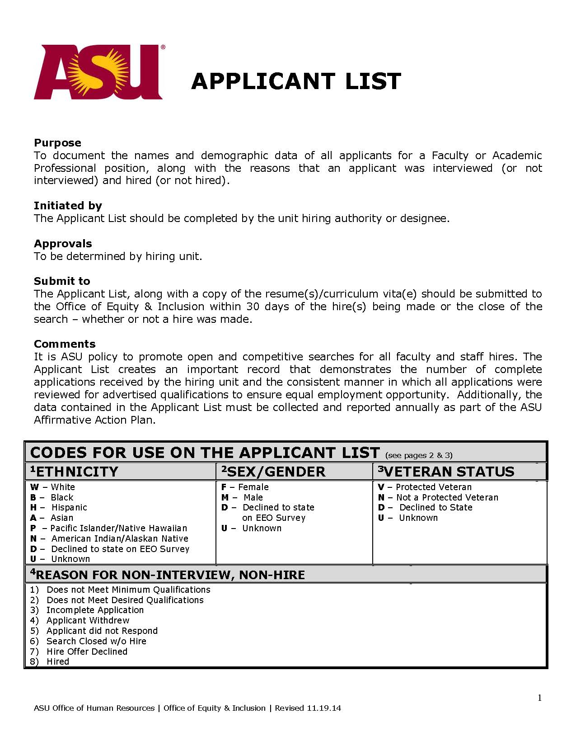
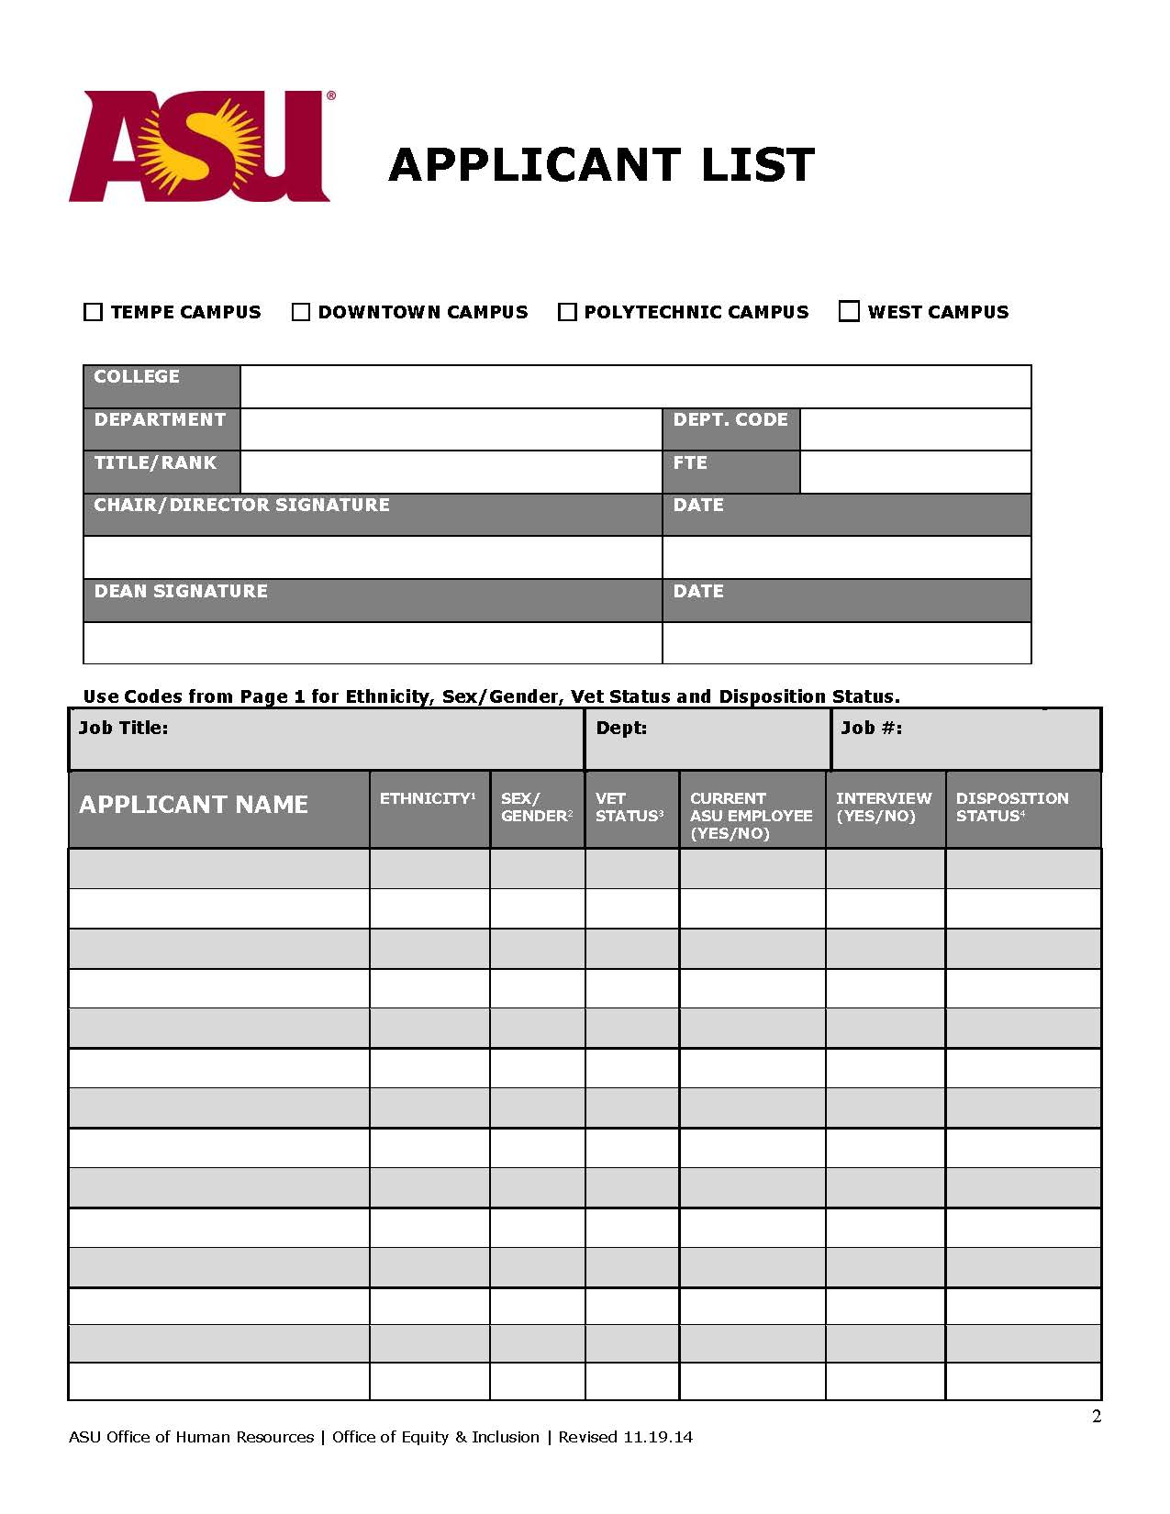
Notes:
This is what the form looks like. The first page describes the form, who fills it out, and the codes for various pieces of information provided for each applicant.
The only allowable source for demographic information is the information provided in the applicant’s response to the EEOA survey (see next page). If an applicant did not respond to the survey, DO NOT GUESS at this information based on surname, appearance, etc. Instead, use the code “D” which, as noted on the first page of the form, indicates that applicant did not respond to the survey.
The last column also documents the reason that particular applicant was not hired or not interviewed using the coded reasons provided on the first page of the form. If it turns out that there is a specific reason for non-interview or non-hire that is not provided in the codes, you may add that reason to the list of reasons on the first page of the form, giving it a number on that page, and then just use the number on the form.

Slide 41
Equal Employment Opportunity Survey
ASU seeks to promote diversity in hiring in order to hire the most qualified applicants
Each applicants should be strongly encouraged to fill out the EEO survey to provide ethnicity, gender, and veteran status information for the pool. This is the only place this information is gathered.
The EEO survey is found online at https://asu.co1.qualtrics.com/jfe/form/SV_3kLYlmgVY2Vfyzb
You will need to provide the applicant the job order number for your position, the job title, and the department name
This information MUST be kept separate from all application materials
Notes:
When a person applies for your position, please respond to the applicant with a request strongly encouraging them to fill out the Equal Economic Opportunity Survey. The survey is at http://www.surveymonkey.com/s/PKNDBNX .
This is the only official source of our data on the diversity of your pool of applicants, so please encourage applicants to volunteer this information.
Be sure to provide the applicant the job order number for your position, the job title, and your department name.
KEEP THIS EEO SURVEY INFORMATION SEPARATE FROM ALL OTHER APPLICATION MATERIALS.

Slide 42
Finishing the search:
References for candidates
Evaluating applicants
Conducting interviews
Notes:
Now, let’s consider some things that happen as searches reach the most advanced stages of the process.

Slide 43
Checking references
Reference checks for all applicants or for all finalists can be done at any time during a search.
Applicants should be notified if references are being contacted beyond those provided.
The same basic job-related questions are asked of each reference. You can follow up on statements offered by references to explore what they mean but at minimum, all references should be asked the same questions.
Notes from references are kept with the position file.
• A current ASU employee finalist may have personnel file reviewed (e.g. move from lecturer in one unit to asst professor in another).
• Direct knowledge includes direct supervision or experience working directly with the applicant.
• Unsolicited reference information: Committee Chair must decide whether this information will be shared within the committee.
Notes:
CHECKING REFERENCES
Applicant references may be checked at any time during a search based on when this information will be most helpful. The hiring authority should advise search committees as to who is responsible for checking references and when these should be checked. Equal opportunity issues in checking references include the following:
• When names of references are requested, consistency is needed in the following areas:
--References must be checked for all applicants who make it to the stage of having references checked.
--Applicants should be notified if the search committee plans to contact references beyond those provided by the applicants.
--The same basic job-related questions are asked of each reference (see Appendix F Pre-employment Inquiry Guidelines for issues to avoid in asking reference questions).
--Notes from the conversations with references are taken and kept with the position file; the position file must be kept for three years from the date of hire.
• Reference information may also be obtained for ASU employees who are finalists for a position by requesting a review of performance evaluations in their college or department academic personnel file.
• Direct knowledge of work performance may be shared by search committee members as part of reference checking; this must be shared for all applicants for whom direct knowledge exists or a decision must be made not to share direct knowledge about any applicant. Direct knowledge may not be used when determining whether the applicant meets qualifications. Direct knowledge includes direct supervision or experience working directly with the applicant.
• When search committee members receive unsolicited reference information from colleagues, students, etc., the committee must decide whether this information will be shared within the committee; the consistency issue is that information is shared on all applicants for whom unsolicited information has been provided or is not shared for any of the applicants.

Slide 44
Evaluating applicants
The critical equal opportunity issue is assuring consistency toward the applicants in the review process.
Notes:
EVALUATING APPLICATIONS
There are multiple methods a search committee can use in evaluating applications; e.g., the committee as a whole can review applications or fewer members may perform this task. The critical equal opportunity issue is assuring consistency toward the applicants in this review process.

Slide 45
Evaluating applicants
In evaluating application materials, the committee as a whole can review applications or fewer members may perform this task.
In all cases, the following guidance applies:
Incomplete applications are not eligible for consideration.
Only the application materials provided are used to determine if applicant meets advertised required qualifications.
Only applicants who meet the required qualifications are eligible for further consideration.
Applicants can be further assessed by the best mix of desired qualifications.
Additional criteria for interview decision may include telephone screenings, reference checks, requests for additional material, etc.
Notes:
In all cases, the following guidance applies:
• All applications still incomplete by the advertised deadline must be set aside; these applicants are not eligible for consideration for the position. The search committee may, however, follow up with applicants who have not submitted all required application material prior to the deadline to encourage them to meet the deadline or to do so by next deadline.
• Only the information provided via the application material may be used to determine whether an applicant meets advertised required qualifications.
• For all complete applications, using the criteria established, determine which applicants do not meet the advertised required/minimum qualifications; only those applicants who meet the required/minimum qualifications are eligible for further consideration for the position.
• If a degree is a required qualification, it must be complete at the start of the appointment for faculty and academic professional appointments. If a degree is not complete at the time of an employment offer, the hiring department must provide evidence from the degree-granting institution that the degree will be completed by the appointment start date. The department may also use the Instructor ABD option in making the offer.
• For all applicants who meet the required/minimum qualifications, using the criteria established, determine which applicants meet the desired qualifications. When applicants do not meet all of the desired qualifications, the committee may reassess applicants several times based on factors such as the best mix of desired qualifications or possession of the most critical desired qualifications or other particularly strong achievements/attainments.
• For applicants meeting all appropriate qualifications, an academic unit may use one or more of the following to make an additional assessment of qualifications to determine which candidates will be interviewed: telephone and/or airport screenings, reference checks, and/or requests for additional material, such as philosophical statements, creative portfolios/tapes (e.g., for art/music positions). Phone or airport screening at this early stage is considered part of the initial qualification review process rather than an interview.

Slide 46
Conducting interviews
Interviews typically involve interactions with multiple employees in a variety of settings.
Administrators or peers inside or outside the hiring unit, internal and/or external constituent groups, students, etc., may participate in the interview process in addition to the search committee and hiring authority.
There is no minimum number of candidates that should be interviewed for a position.
Interviews may be on campus, conducted at some other location, or by telephone.
Develop a variety of methods to assess candidates.
Notes:
CONDUCTING INTERVIEWS
Interviews typically involve interactions with multiple employees in a variety of settings. Administrators or peers inside or outside the hiring unit, internal and/or external constituent groups, students, etc., may participate in the interview process in addition to the search committee and hiring authority. Interviews may be on campus, conducted at some other location, or by telephone. The type of interview conducted is based on academic unit bylaws and/or is determined by the hiring authority.
There is no minimum number of candidates that should be interviewed for a position. If, for example, a single applicant is far and away clearly the most qualified person, only that person needs to be interviewed.

Slide 47
Conducting interviews
Interviews must be consistent.
The interview method and agenda are the same for all candidates.
Internal candidates are treated the same as external candidates.
The same basic set of questions is asked of all candidates.
Committee members should make every effort to attend all interviews.
• If an applicant requests a disability accommodation to
participate in an interview, contact the Office of Equity
and Inclusion.
Notes:
• The interview method and agenda are the same for all candidates interviewed. The method/agenda of an interview may change, however, depending on whether it is a preliminary interview, initial campus interview, or final campus interview; the consistency of treatment of applicants must be within the interview category.
• Internal candidates interviewed are treated the same as external candidates interviewed. (Here, “same” means identical in substance. This does not require, to take a ludicrous example, that every candidate be taken to the same restaurant at the same time on the same day of the week and forced to order the same thing.)
• The same basic set of questions is asked of all candidates interviewed by the search committee; the same basic set of questions (although usually different than those asked by the search committee) is asked of all interviewees by the hiring authority.
• Search committee members should make every effort to attend all interviews. In the case of an absence or illness, those members who conduct the interview may share their assessment with the absent member(s).
• Public forums or department/college open forums for candidates may have different individuals attending for each applicant without creating inequities in the search; it is usually impossible to guarantee participation in these situations, and attendees do not have the same role in the search as members of the search committee.
• Develop a variety of methods to assess candidates during interviews in addition to or instead of question/answer sessions. For example, create a skills assessment exercise involving a typical function of the position, request short presentations when appropriate to the position, or provide written questions and ask for written responses.
• Tests may not be used as an evaluative tool unless that test has been validated for the position in accordance with the federal Uniform Guidelines on Employee Selection. The Office of Diversity must approve and maintain a copy of the test used to select candidates for employment.
• If an applicant requests a disability accommodation to participate in an interview, contact the Office of Diversity for assistance before agreeing to or declining the requested accommodation. To avoid an awkward moment, you might say during the email, phone call, etc. where you are arranging the interview, “should you need an accommodation for a disability, please let me know as soon as possible.”

Slide 48
Notes:
https://www.youtube.com/watch?v=xbC4Yd_aljo&feature=youtu.be

Slide 49
Recordkeeping requirements
All ASU forms, written communications (whether electronic or hard copy), application material, notes, and records related to recruitment for a position (referred to as a “position file”), must be retained by the academic unit for three years from the date of hire.
The following must be submitted to the Office of Equity and Inclusion within 30 days of the position being filled:
Faculty/Academic Professional Search Plan and Advertisement Copy
The completed Applicant List.
The résumé or curriculum vitae of the person(s) hired.
Notes:
RECORDKEEPING REQUIREMENTS
All ASU forms, written communications (whether electronic or hard copy), application material, notes, and records related to recruitment for a position, referred to as a position file, must be retained by the academic unit for three years from the date of hire.
Equal opportunity surveys sent by a department and returned by applicants must be kept separate from an individual’s application material.
Additionally, the following must be submitted to the Office of Equity and Inclusion within 30 days of the position being filled.
1. Faculty/Academic Professional Search Plan form and the copy of the advertisement(s).
2. The completed Applicant List form.
The resumé or curriculum vitae of the person(s) hired.

Slide 50
Permanent residency for
academic positions
Contact the International Students and Scholars Office at 480-727-4776 for resources related to hiring international faculty.
Questions about visa status or other immigration related matters should also be directed to that office.
Notes:
Visa or residency questions can be referred to the International Students and Scholars Office.

Slide 51
Questions?
Notes:
Please feel free to send any questions about searches to the Vice Provost for Academic Personnel, Barry.Ritchie@ASU.edu

