Slide 1
Academic Plan Best Practices 2021 – 2022 How to receive fewer questions from us and improve your chances of approval
Office of the University Provost & the Graduate College Present:

Slide 2
Overview of the Academic Plan
Mandated by ABOR for new degree programs and changes to established degree programs
Upon receipt of the final approval memo, the academic plan requests provides approval to begin the formal proposal process internally at ASU

Slide 3
New for this year
All undergraduate programs must include General Education assessment components with their assessment plans. First drafts are due to the University Office of Evaluation and Educational Effectiveness by July 31 and final drafts are due August 31st.
Certificate programs must also submit an assessment plan.

Slide 4
Review Process
University Review
Vice Provost & Graduate Dean
Provost Review
ABOR Review
Final Decision Memos Distributed
You may receive questions from the Provost’s Office or the Graduate College during each review stage. A central academic plan contact for your college may help this process run smoothly.

Slide 5
Timeline & Important Dates
Curriculum Changemaker Submissions Due: May 1, 2020
Initial Learning Outcomes and Assessment Plans Due: July 31, 2020
Final Learning Outcomes and Assessment Plans Due: August 31, 2020
University Review: May – November 2020
ABOR Review: October/November, 2020
Final Responses: Early December, 2020

Slide 6
Types of Academic Plan Requests
New Programs (degrees, certificates, minors and concentrations)
Program Changes (name change, disestablish or move)
New Academic Unit
Changes to an Existing Academic Unit (department, division, school or college)

Slide 7
ABOR Expectations
Audience
Justification
Market Demand
Assessment/Outcomes
Program Fees
Formal
Intelligent
External to ASU
Strong, well-written descriptions and justifications
New this year: 300-400 word maximum
Refer specifically to the job market for graduates
Include defensible data
Robust learning outcomes and actionable assessments
3 learning outcomes rather than 2
Well-reasoned program fees
Fee totals (not including tuition)

Slide 8
Should We Propose a New Program? (Degree, concentration, certificate)
Can the proposed program be integrated with current offerings?
Can an existing program be renamed/retooled?
If there existing programs already at ASU that might meet this niche? Is there a collaboration opportunity?
Is the program appropriate for the existing college?
Is the degree type appropriate for the degree? Professional vs research.
Is the major name appropriate for the field? Realistic?
Are the enrollment numbers appropriate?

Slide 9
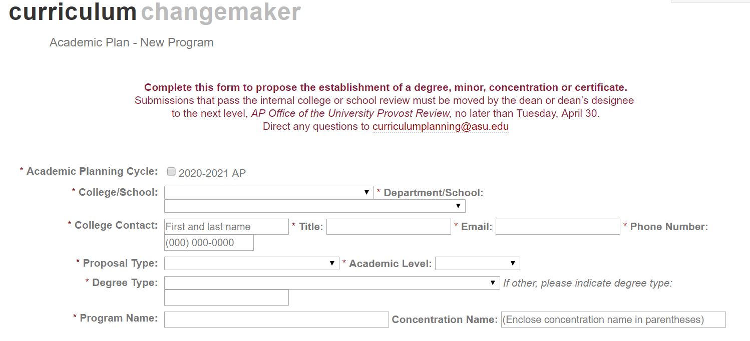
Completing the Requirements
What now?!
Best practices for the completion of the requirements of the academic plan form in Curriculum ChangeMaker

Slide 10
The Process: Curriculum ChangeMaker

Slide 11
Learning Outcomes & Assessment Plans
Make sure these are submitted for each program through the University Office of Evaluation and Educational Effectiveness assessment portal. Once UOEEE approves, info transmitted to ChangeMaker.
Be prepared to address learning outcomes, concepts, competencies, assessment methods and measures for each new degree or concentration program. Create measures that are challenging but attainable.
ABOR requires 3 learning outcomes, rubrics are strongly recommended, and overall quality minimums are expected. Plans must be able to generate findings usable for continuous improvement efforts.
Use multiple performance criteria and measurements, with at least one direct measure required for each outcome. Validity and reliability concerns should be addressed as the program progresses.
Assess students during the program and at completion to help drive continuous improvement efforts.
Visit https://uoeee.asu.edu/ for more information and resources.
Assessment plans are not needed for minors and certificates plans are optional and may be submitted as needed.

Slide 12
Program Fees
ABOR requires us to indicate whether ASU’s newly requested programs have will have a program fee and how much per semester is anticipated.
This includes existing fee structures that have already been setup with Budget and Planning.
Proposed program fees must be reviewed and approved through the current budget and tuition/fee approval process. Contact Sheila Ainlay for more information on how to have your program fees approved.

Slide 13
Additional Resources/ University Funds
To request university funds to implement a change (new faculty, new academic or office space, renovations, capital equipment), complete the Academic Plan Resources form to document the need.
Additional resources may include new faculty, new academic or office space, renovations, capital equipment,
etc.

Slide 14
Collaboration
shared curriculum or resources
courses taught by multiple colleges or units
joint degrees conferred by two colleges
Includes
Ensure that conversations regarding collaboration have occurred before the request is submitted, and be ready to speak to the nature of the collaboration.

Slide 15
Justification
Audience – formal, intelligent and external to ASU
300-400 Words
No acronyms except for approved degree abbreviations (ex. The CHS SHS BS…)
No jargon or shortcuts
Present a description of the program AND a justification that presents the case that this program is necessary and important to ASU.

Slide 16
Market Need
Job Market
Data
Career opportunities Job market strength
Job Outlook
Growth
Other Programs
Sources
Resources
What is the market need? Think of it this way: What value does this degree offer to students?
Include source attribution for statistics provided
EMSI Burning Glass Bureau of Labor Statistics
Professional and Trade Organization Sources

Slide 17
FAQ
Q: Once we receive Academic Plan Approval for a new program, can we launch it right away?
Q: When will we be notified that our Academic Plan requests are approved/denied?
Q: What are Concepts and Competencies?

Slide 18
Contacts & Resources
Contacts:
General questions should be directed to curriculumplanning@asu.edu.
Assessment plans - assessment@asu.edu
Program fees - Sheila Ainlay
Digital immersion - edplusprogrammanagement@asu.edu
Centers or institutes - centers-institutes@asu.edu
Find resources, links and more information at:
https://provost.asu.edu/curriculum-development/academic-planning-cycle

Slide 19
Questions?

